Slide 1
Research report
Xiaoshu Luo

Slide 2
28-day Concrete strength
ANN using sklearn
ANN using pytorch
Optimize parameters using pso from pyswarm package

Slide 3
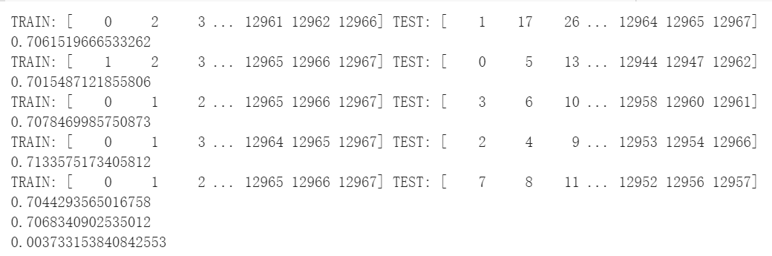
Result from sklearn MLPRegressor and pytorch
Using 1-layer, the optimized result is 29 neurons using lbfgs as optimizer. (Average R2 is 0.704 using cross validation)
Using 2-layer, the optimized result is 21 and 24 neurons using lbfgs as optimizer. (Average R2 is 0.703 using cross validation)
*More layers will use up all the memory resource, and manually adjusting the parameters does not achieve a better result
* The optimized result is based on a single train-test splitting of the dataset
* Cross validation will use up all the GPU resource and stop the script
*Learning to use Bayesian optimization in skopt

Slide 4
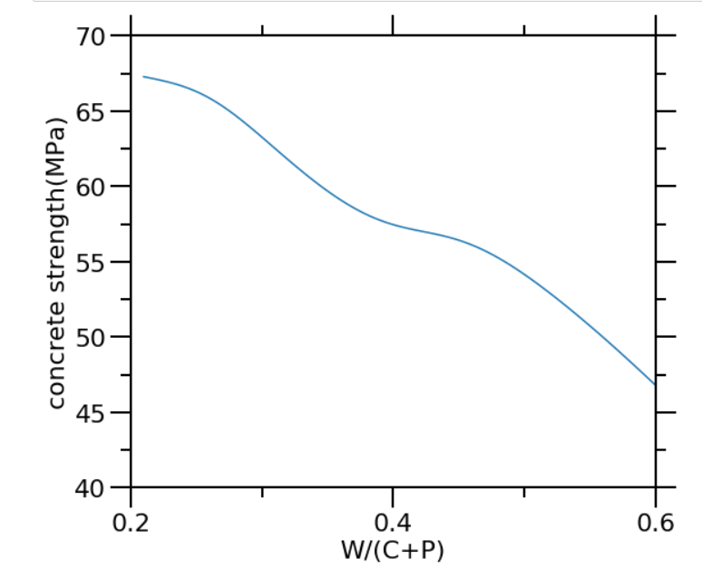
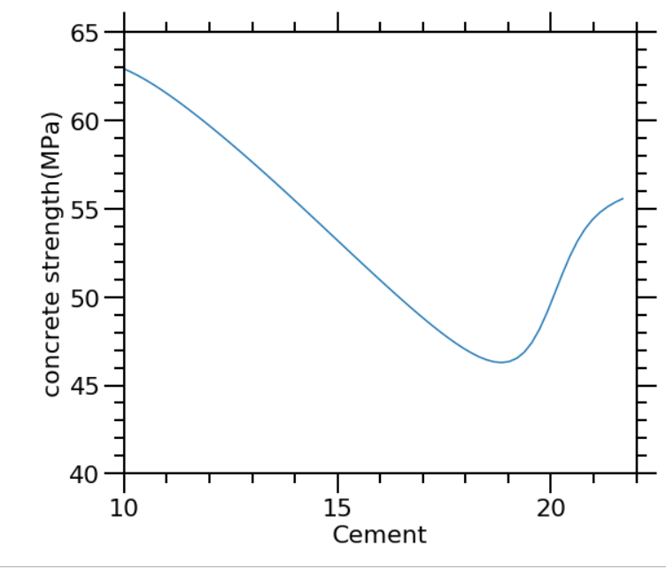
Graph for cement and w/(c+p) for 1-layer sklearn

Slide 5
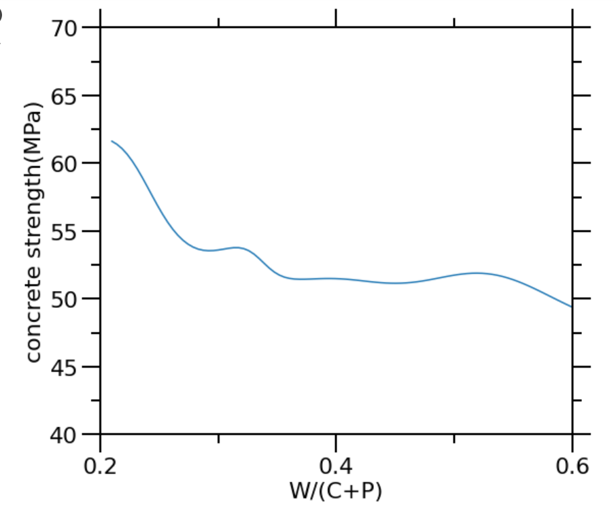
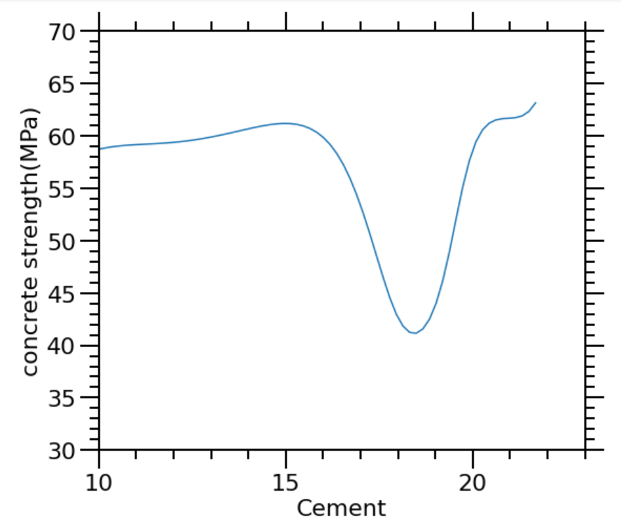
Graph for cement and w/(c+p) for 2-layer sklearn

Slide 6
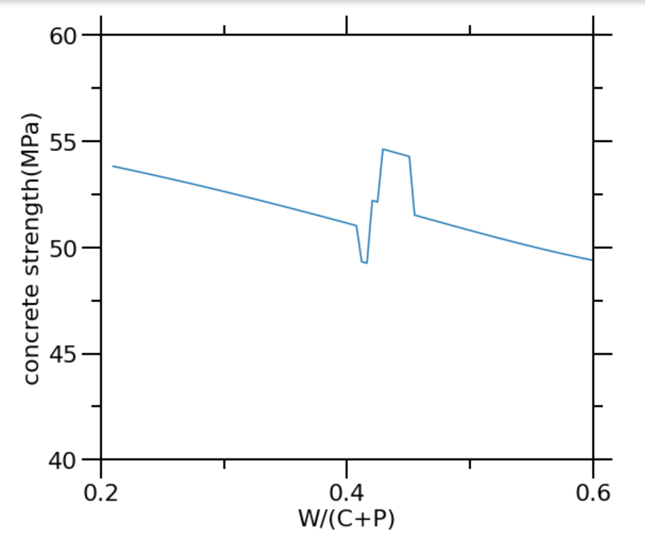
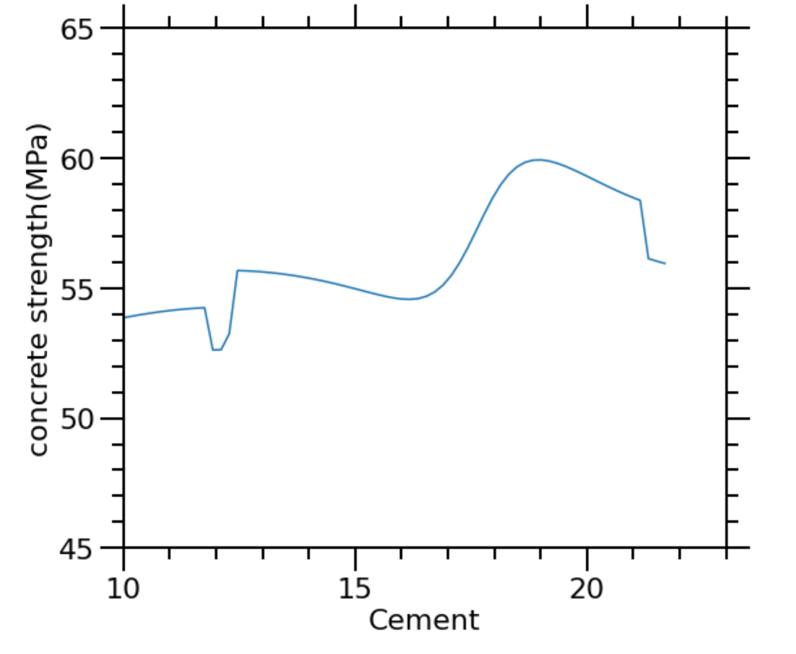
Graph for cement and w/(c+p) for 1-layer pytorch

Slide 7
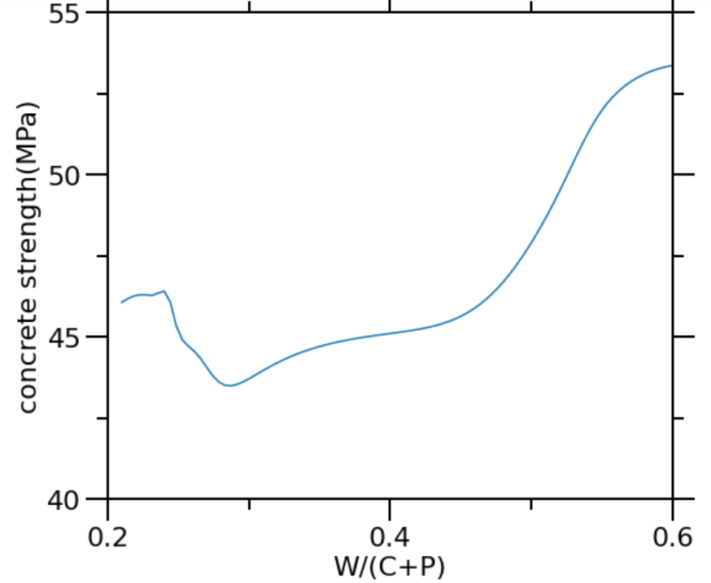
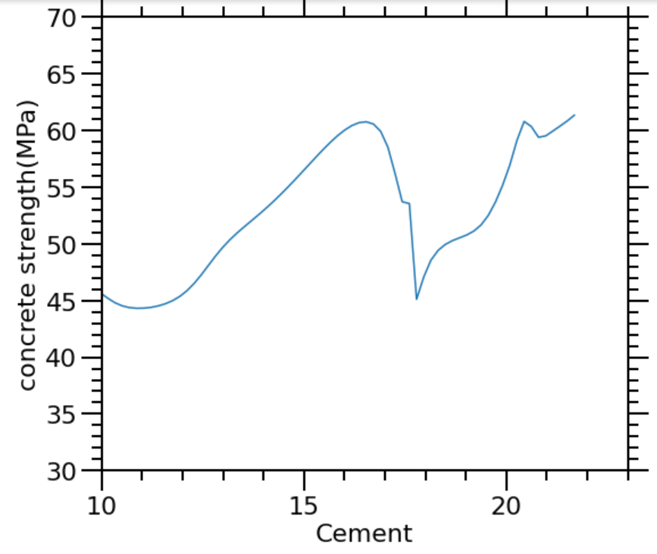
Graph for cement and w/(c+p) for 2-layer pytorch

